Slide 1
Ludology
The Psychology of Fun
Licensed by the University of Toronto Embedded Ethics Education Initiative and Steve Engels under the Attribution-NonCommercial-ShareAlike 4.0 International license.

Slide 2
Ludology: The psychology of fun
The fundamental purpose of games is to make a “fun” experience.
How do we identify the fun elements in existing games?
How do we take an idea for a game and make it “fun”?
Notes:
Photo by Alena Darmel: https://www.pexels.com/photo/woman-in-sleeveless-shirt-playing-computer-game-7862595/

Slide 3
Objectives For Today
Learn to identify what makes a game fun for your audience.
Also, what can make it less enjoyable for certain players.
Add layers of fun to enhance the core game experience.

Slide 4
Game mechanics
Game mechanics refer to the fundamental elements of your game that you use to engage your player.
Gameplay usually refers to the experience that you want your player to have, and employs game mechanics in order to achieve those goals.
What are examples of core game mechanics?

Slide 5
Final Ludology Considerations
Communication
Challenge
Aesthetics
Stimulation

Slide 6
Learning to Communicate
Games are communicating constantly with the player.
(avoiding text, unless absolutely necessary)
What needs to be communicated?
What is the player is meant to do.
Goals, subgoals, motivation.
How is the player should do it.
Controls, actions, strategies.
Is the player doing well?
Rewards, feedback.

Slide 7
Understanding the Player
“My game is communicating fine already”
If you’re sure, your playtesters will verify this.
As a developer though, you know your game far better than your players.
What’s the best way to teach your player what you know about the game?
Notes:
Screenshot by Steve Coyne (Walking Dead, Telltale Games), used under fair use

Slide 8
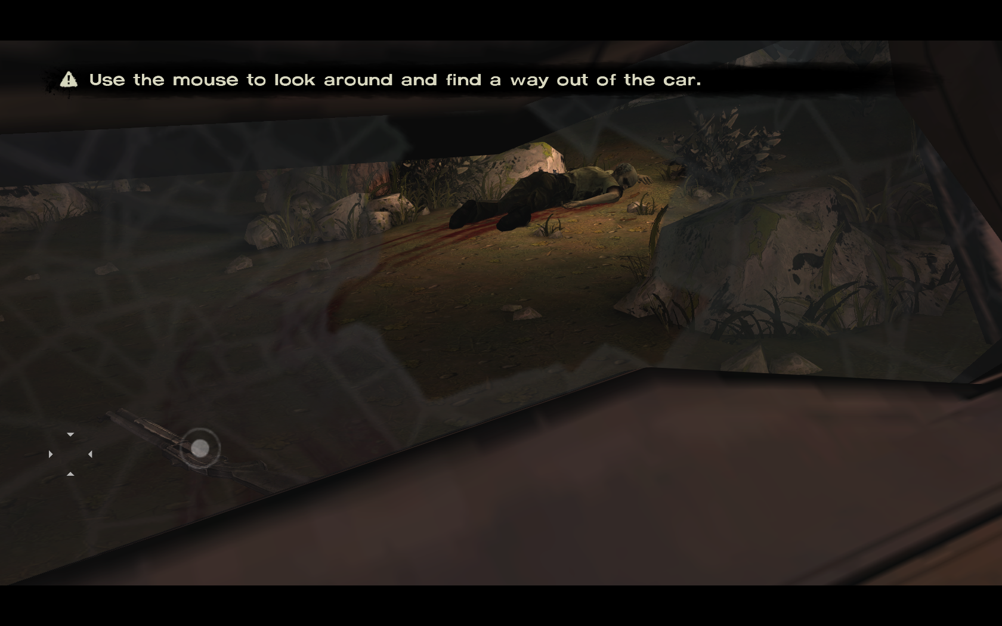
Notes:
Screenshot by Steve Coyne (Walking Dead, Telltale Games), under fair use

Slide 9
What the player needs to do
Revisit level design principles.
Draw attention to key parts of your level through light, contrast, camera angle, collectible objects, sound, animations, etc.
Avoid text (assume that players don’t read)
Q: Which approach is the most effective?
A: All of them.
The more cues, the more the better.

Slide 10
What can the player do?
In addition to communicating the objectives for the player, you also need to communicate the actions the player can take, when they take them.
Avoid pages of instructions when you start the game.
Revisit UI/UX principles.
Tutorial levels with gateways tasks for main UI actions.
Arrows, highlight interactable objects, show action options.
Create & highlight path to the goal.

Slide 11
Case Study: Shadow of the Tomb Raider
In the following clip, Lara Croft is exploring underground caves to find a lost city.
Can you spot what the developers are doing to communicate the actions and the directions that players should take?
Notes:
Screenshot by Steve Engels (Walking Dead, Telltale Games), used under fair use

Slide 12
Progress & Feedback
Interactive media → continuous feedback:
Reinforcing behaviour
Indicating progress
Providing stimulation
Feedback needs to be visual, auditory, sensory, olefactory, whatever you can manage.
Tell the player what they are doing right and wrong. Constantly. In multiple ways.
Example: Boss battles

Slide 13
Challenge
Notes:
Photo by Pixabay: https://www.pexels.com/photo/person-climbing-on-mountain-461593/

Slide 14
Achieving optimal challenge
Several different types of challenge elements.
Example: enemies and bosses.
“Optimal Flow”
Technique for increasing difficulty level
Helps player acquire and enjoy new skills
Difficulty elements
Reflex skills
Enemies vs bosses
Adaptive AI
Video game clichés
Jumper levels, protecting the weak, locked room, stealth, timed levels, etc.
Difficulty
Frustration
Boredom
Time

Slide 15
Adding Challenge
The challenge of games is what turns them from simply interactive to addictive.
Video game addicts exhibit many of the same signs as people with gambling addiction.
Combination of challenge and rewards.
Consider using psychology theory to enhance the engagement/addiction level of your game

Slide 16
Psychology Examples
Cognitive Dissonance
People alter their belief system to fit with their actions or other conflicting beliefs.
Festinger and Carlsmith: Subjects were instructed to perform a task, where some were paid and some weren’t.
Unpaid subjects attributed their actions to their intrinsic motives.

Slide 17
Scaling the challenge
General advice for adding challenge:
Curate a scaffolded, purposeful experience.
Create levels that introduce one type of enemy or player interaction and explore that thoroughly before adding the next.
Your easiest level isn’t easy enough.
Make one that is laughably easy, and then one even easier than that.
That’s how tutorial levels are typically created.

Slide 18
Challenge in different forms
Need to introduce the challenge elements in different ways, depending on audience and domain of game.
Examples:
Strategy games
Problem-solving
Using environment
Cooperation
Resource management games
Ammunition/items
Health
Money
Time

Slide 19
Example: Warcraft 3
General RTS Gameplay
Insert clip of RTS gameplay (e.g. https://www.youtube.com/watch?v=Q2zfx5hQ3CE)

Slide 20
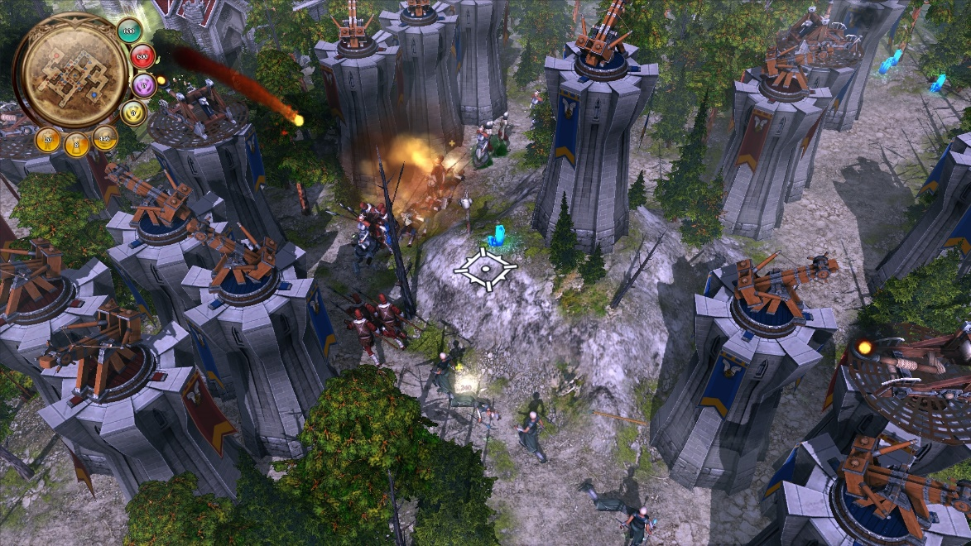
Example: Defenders of Ardania
Tower Defense
Notes:
Image source: https://en.wikipedia.org/wiki/Tower_defense#/media/File:Defenders_of_Ardania_2.jpeg

Slide 21
Striking a Balance
Balance is necessary when multiple options (strategies, characters, weapons) are available.
Need to make sure that no approach has unfair advantages.
Also ensure that each player type can win multiple ways with multiple approaches.

Slide 22
Playtesting, again
Playtest early & often.
Playtesting data helps to illustrate communication and challenge issues that you didn’t know to anticipate.

Slide 23
Example: Portal dev clip 1
Insert clip of RTS gameplay (e.g. https://www.youtube.com/watch?v=Q2zfx5hQ3CE)
Notes:
Written text of commentary is available here: https://theportalwiki.com/wiki/Portal_developer_commentary

Slide 24
Polish + Aesthetics
Notes:
Screenshot by Steve Coyne (Inside, Playdead), used under fair use

Slide 25
Immersion
Immersion is a key goal of your game.
Enhanced by cohesion and consistency.
Disrupted by distractions and glitches.

Slide 26
Some notes on immersion
Immersion ≠ Realism
Need aspects of both realism and “unrealism”
“Unrealism” allows players to interact with a consistent imagined world.
Achieving immersion:
Consistency
Agency
Freedom
Customization
e.g. Sims

Slide 27
Aesthetic elements
Environment, object and character art should complement the gameplay.
Once gameplay and levels are settled, aesthetic elements can make all the difference
Music & sound are is vital and should be integrated early.

Slide 28
Video Games Live
Insert video clip from: https://www.videogameslive.com/media/

Slide 29
Stimulation
Stimulation is the most obvious game component for most people.
However, people often misunderstand “stimulation” to mean the selling features of most action movies.
Stimulations is a more general term, connected to the senses:
Graphics
Sound effects
Responsive environment
Non-trivial death
Visual markers, rituals
Notes:
https://en.wikipedia.org/wiki/Dance_Dance_Revolution#/media/File:Dance_Dance_Revolution_gameplay.gif

Slide 30
Stimulation
Other aspects of stimulation:
Physiological arousal
Adrenaline
Capilano bridge study.
Physical activity
DDR, Kinect games.
Humour
Makes games “stickier”.
Emotional response
Fear, social stimuli.
Insert GIF from: https://en.wikipedia.org/wiki/Dance_Dance_Revolution#/media/File:Dance_Dance_Revolution_Extreme_arcade_machine_left_side_stage.png
Notes:
https://en.wikipedia.org/wiki/Dance_Dance_Revolution#/media/File:Dance_Dance_Revolution_Extreme_arcade_machine_left_side_stage.png

Slide 31
Psychology Examples
Capilano Suspension Bridge Study
Illustrates “misattribution of arousal”.
Subjects were interviewed on the Capilano bridge, or on a different bridge that was much more sturdy.
Results show that participants attributed state of arousal to interviewer, not their location.
Principle can be extended to active games as well.
Notes:
https://en.wikipedia.org/wiki/Capilano_Suspension_Bridge#/media/File:Capilano_Suspension_Bridge,_Vancouver,_Canada_(July_2016)_1.jpg

Slide 32
Rewards
Rewards reinforce behavior and add gameplay elements.
Challenge + Rewards → Addiction.
As with the other game elements, rewards can take many forms:
Sensory content
“Dings”
Musical fanfare
Cutscenes & animations
Advancing storyline
Items
Loot/money
Weapons, items & upgrades
Unlockables & codes
Positive reinforcement
Points/score
Achievements
Leveling up
Intrinsic motivation
Beating bosses
Social rewards

Slide 33
Psychology Examples
Variable Ratio Schedule (B.F. Skinner)
Skinner associated positive and negative reinforcement with various actions (operant vs classical conditioning).
Food pellets for mice that press a lever.
What was the effect of making the reward come less regularly?
How does that apply to games?
Notes:
Photo by Tanner Johnson: https://www.pexels.com/photo/two-gray-mice-inside-brown-house-53813/

Slide 34
Psychology Principles
Classical conditioning (Pavlov)
Pairing two stimuli together, one of which generates a particular response.
Result: Both stimuli generate the given response.
Notes:
Photo by Eduardo López: https://www.pexels.com/photo/black-man-drools-16618350/

Slide 35
More Psychology Examples
An understanding of basic psychology can go a long way toward making people play/enjoy your game.
Example: social psychology
Halo Effect
General evaluations of a person lead us to assume things about their other characteristics.
Social Identity Theory
Players will want to form groups and indentify similar players in multiplayer situations.
Conformity Bias
People tend to go along with the group, even when the group is wrong.

Slide 36
The Attention Economy
When combined properly (communication + challenge + stimulation), the resulting game creates a compelling experience that players have difficulty disengaging from.
High immersion and long gameplay are key indicators of enjoyment for your games:
Players feel compelled to go further into your game,
There is a physical and mental impact on the player,
At its peak, there’s a sense of withdrawal and longing that comes from putting it down.
Licensed by the University of Toronto Embedded Ethics Education Initiative and Steve Engels under the Attribution-NonCommercial-ShareAlike 4.0 International license.

